Slide 1
Breast Cancer detection using AI
By Kavya pothula and Sai Priya Mallu

Slide 2
Introduction
The most common issue related to health is the breast cancer mostly in female. According to one of the survey in 2012 because of the breast cancer 522000 deaths occur and increase the death ratio upto 14% which were in 2008.By the introduction of medical imaging it brought a huge revolution in medical field. This helps medical staff to interpret the whole case easily. Besides of medical imaging by the introduction of Artificial intelligence made a huge change in medical side.

Slide 3
Objective & Problem statement:
The main objectives of this project are
1. To identify the cancer in early stages by Deep learning.
2. To classify the types of breast cancer.
3. To make it easy for medical stuff to interpret the results easily and quick.
4. To decrease the death rate because of breast cancer to cure them on time.

Slide 4
Dataset:
In this project we used Kaggle dataset. This dataset is publically available for the research purposes. This dataset consist of two types of cancer one is Benign and other one is malignant. Therefore we have one folder for benign breast Cancer images and other folder for the purpose of malignant breast cancer images. We have total number of 10000 breast cancer images. But originally the number of images were round about 2000 which is too small for the training of model, therefore we employ a technique of data augmentation and make the total datasets becomes four times and ease for the training of the model because deep learning needs a lot of data for good and efficient result. Some of the data are given below in the following figures for Breast cancer benign and malignant.

Slide 5
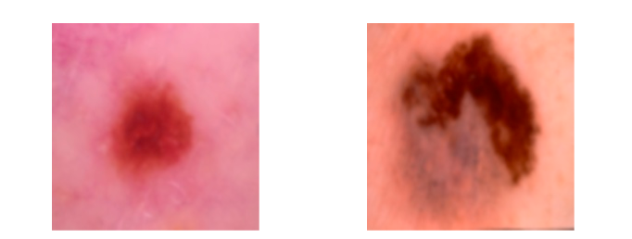
Figure:
Figure: (a) shows benign breast cancer and (b) shows malignant cancer

Slide 6
Methodology:
Input Data
Pre-processing
Some of the preprocessing methods are
1. Resizing
2. Augmentation
3. Normalization
4. Splitting Of Dataset
5. Vgg Model
6. Classification

Slide 7
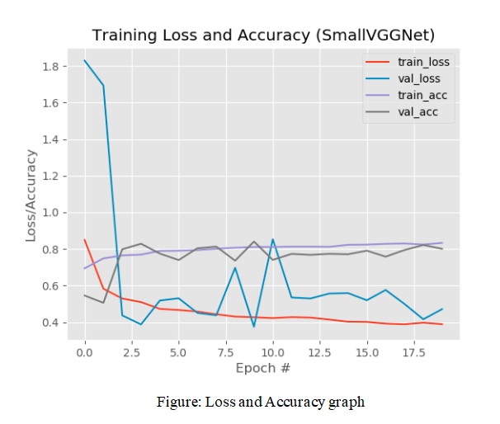
Results:
As the model is trained then we used the test data in order to check our model performance. To check any model performance training and validation loss and accuracy is very important. That can be seen in the following figure

Slide 8
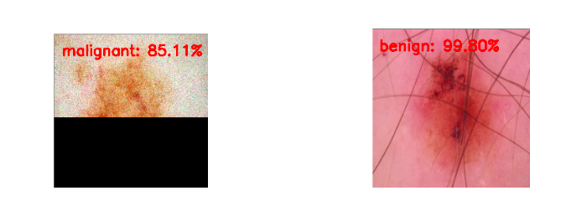
And the accuracy for both classes is 82%. After the training the model we used some UN train data in order to check our trained model prediction for images. And the results were brilliant which can be seen in the following figures.
Figure: (a) shows output of malignant cancer (b) shows benign cancer

